Slide 1







Data for Change
Capacity Building Learning Series
Designing with Care – Integrating User-Centered and Trauma-Informed Practice
Thursday, October 2, 2025
1:30pm-3:30pm
Presented by: Council of Agencies Serving South Asians (CASSA)
In Partnership With:
Supported by:

Slide 2

Land Acknowledgement
The work of the Council of Agencies Serving South Asians (CASSA) takes place on traditional Indigenous territories of the Huron-Wendat, Haudenosaunee, and most recently, the territory of the Mississaugas of the Credit First Nations. This territory is part of the Dish with One Spoon Treaty, an agreement between the Anishinaabeg, Haudenosaunee and allied nations to peacefully share and care for the resources around the Great Lakes. This territory is also covered by the Upper Canada Treaties. Today, Tkaronto, the traditional Mohawk name of this area called Toronto which means “trees in the water,” and its surrounding areas are still home to Indigenous people and we are grateful to have the opportunity to meet, work, and play on this territory as settlers.

Slide 3
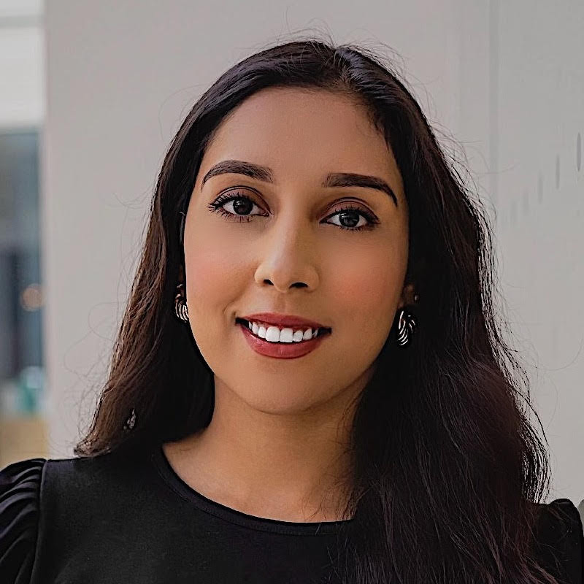

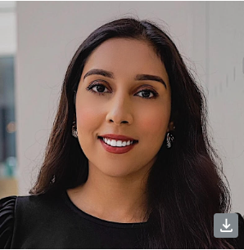
CASSA Team
Ridah Asghar (she/her)
Director of Development
Qurat Al Ain (she/her)
Executive Assistant/Membership Coordinator and Admin Assistant at TNN. Diploma, Accounting and Business

Slide 4

Council of Agencies Serving South Asians (CASSA)
An umbrella organization with over 120 member agencies. Our mandate is to cultivate the social, economic, political and cultural empowerment of South Asians by serving as a resource for training, research, knowledge mobilization, leadership and capacity building for South Asians, racialized and other marginalized communities.
CASSA aims to create social and systemic change through coalition building, and partnering with other community organizations and institutions who share a similar vision of equipping the communities they serve with the necessary tools, knowledge and resources in order to successfully participate and contribute to Canadian society in all sectors.

Slide 5
Agenda
Land Acknowledgement
Introduction of CASSA
Overview of Data for Change Project
Overview of CoP & Ground Rules
Fireside Chat & Panel Discussion
Fireside Q&A
Break
SHIP & Logical Outcomes Presentations + Q&A
Close-out

Slide 6
Project Objective
To test SID collection with more service-users to better understand how to best support agencies in:
collecting socio-demographic data
using the data to advance better outcomes for equity-deserving communities
socializing the collection methodology & use of tools across the community social services sector

Slide 7




Data for Change Project Model
Knowledge Mobilization Hub
Project Logistics
Partner Convening
Host Knowledge Mobilization Online Hub
Community of Practice &
Partnership Table
Partnership Table support & participate in project implementation
Community of Practice features a panelist discussion & peer support network for agencies
Community of Practice &
Partnership Table
Capacity Building Sessions
Facilitate capacity building sessions to support agencies with data collection & responsible usage
Capacity Building Sessions
Facilitate capacity building sessions to support agencies with data collection & responsible usage
KNOWLEDGE MOBILIZATION HUB

Slide 8
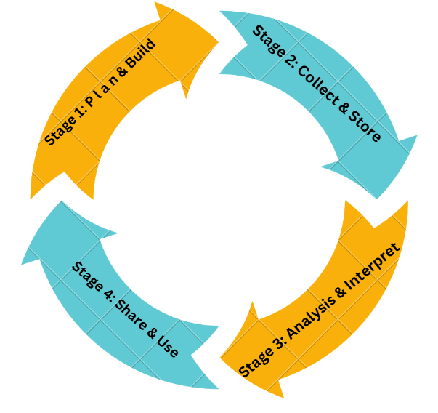
STAGE ONE: PLAN & BUILD
STAGE TWO: COLLECT & STORE
April: Organizational Readiness
June: Org. Change Management
May: Foundations of Data Collection
July: Data Infrastructure
DATA EQUITY 3.0
May: CoP
July: CoP
STAGE THREE: ANALYSIS & INTERPRET
STAGE FOUR: SHARE & USE
August: Trauma Informed Practice
October: Uses of Data
September: Consent & Privacy
November: Data Analysis Framework
September: CoP
December: CoP

Slide 9
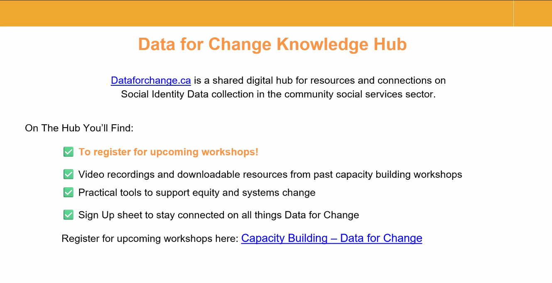

Slide 10
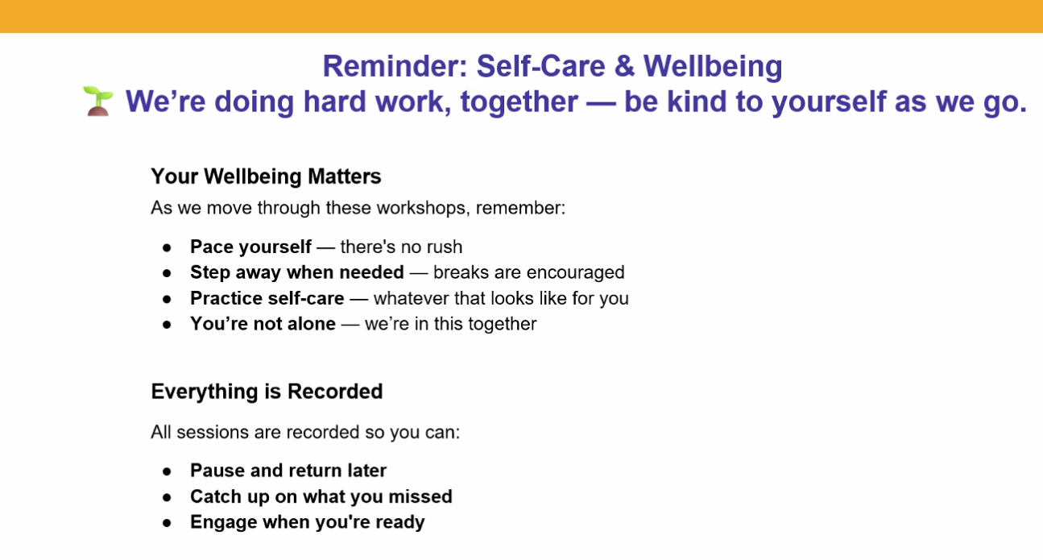
r

Slide 11
Community of Practice (CoP)
Purpose of a CoP:
Collective Learning: Foster collaboration, knowledge exchange, and leadership development among leaders within the non-profit sector.
Collective Sharing: Challenges, innovations, and strategies in non-profit leadership, governance, funding and impact.

Slide 12
Community of Practice (CoP)
Ground Rules for CoP
Brave spaces and building trust
Respectful communication
Maintain confidentiality
Openness to diverse perspectives
Inclusivity

Slide 13
Fireside Chat

Slide 14
Unison Health and Community Services
Julie Callaghan
With a prior background in co-operative housing, adult education and international NGOs, Julie Callaghan has worked at Unison Health and Community Services in Toronto for the past 20 years. Julie leads a team with responsibility for program planning and evaluation, performance measurement and accreditation, as well as direct services in housing, adult developmental services, harm reduction and health promotion. She was involved in the development of two community hubs for which Unison is the lead agency – the Jane Street Hub and the Bathurst-Finch Hub. Julie and team are also active at a number of other Toronto tables, including Ontario Health Teams and Community Clusters.

Slide 15
North York Seniors Centre
Jamie-Lynn Parker
With over seven years of experience working closely with the senior community, Jamie brings deep compassion, expertise, and leadership to her role as Director of Program and Support Services at North York Seniors Centre. Her professional journey began in mental health and acquired brain injury (ABI) services, where she developed a strong foundation in person-centered care and advocacy. Jamie leads a dedicated team committed to empowering seniors to live safely, independently, and actively within their communities. Under her direction, the agency delivers a comprehensive suite of services—including recreational and educational programs, adult day programs, in-home supports, transportation, and personalized client services, all rooted in values of compassion, inclusiveness, and quality.

Slide 16
Questions and Answers
If you have any questions for Julie or Jamie please email dataforchange@findhelp.ca.

Slide 17

🌱 Mental Health Break
⏳ We’ll continue in 5 minutes

Slide 18
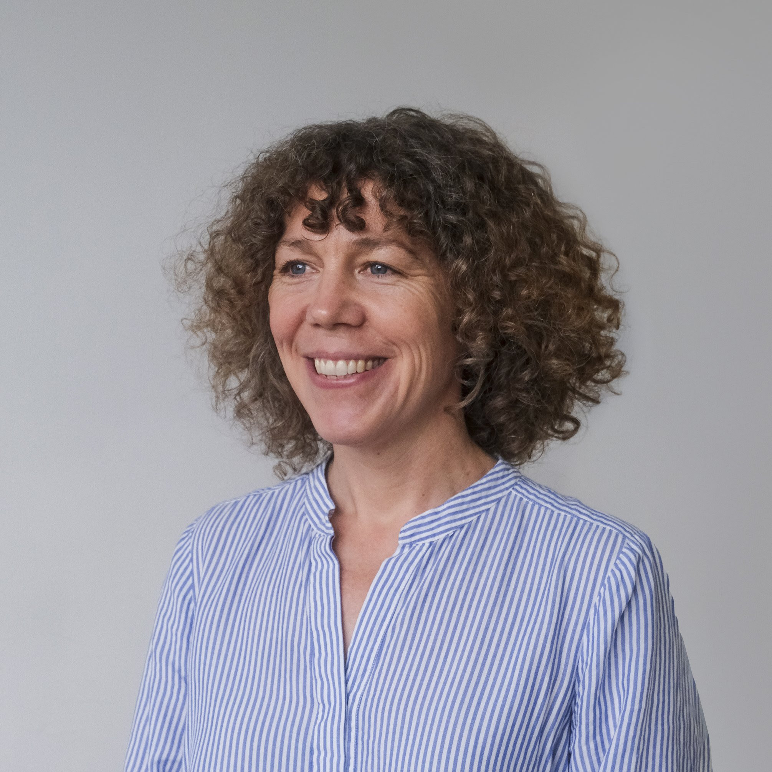

Logical Outcomes : AI for data visualization: Considerations and tips
Sophie Llewelyn Medha Aurora
Director of Evaluation and Research Evaluation Analyst

Slide 19


SHIP : “From Vision to Impact: Health Equity Action Plan
Nicole Abruscato Shereen Rampersad
Manager Manager
Central Intake & Access EDI
Clinical Health & Wellness Professional Services

Slide 20
We’d love to hear from you!
💬 Questions? Ask about anything we’ve covered—or anything we haven’t!
🌟 Best Practices: What strategies or tools has your organization found helpful?
🤝 Let’s Collaborate: Share your insights and challenges. We're all here to learn.
📝 Feedback
Share your feedback with us on the Menti poll in the next slide

Slide 21

Instructions for Poll
Go to
www.Menti.com
Enter the Code
1892 3164
or scan QR Code

Slide 22
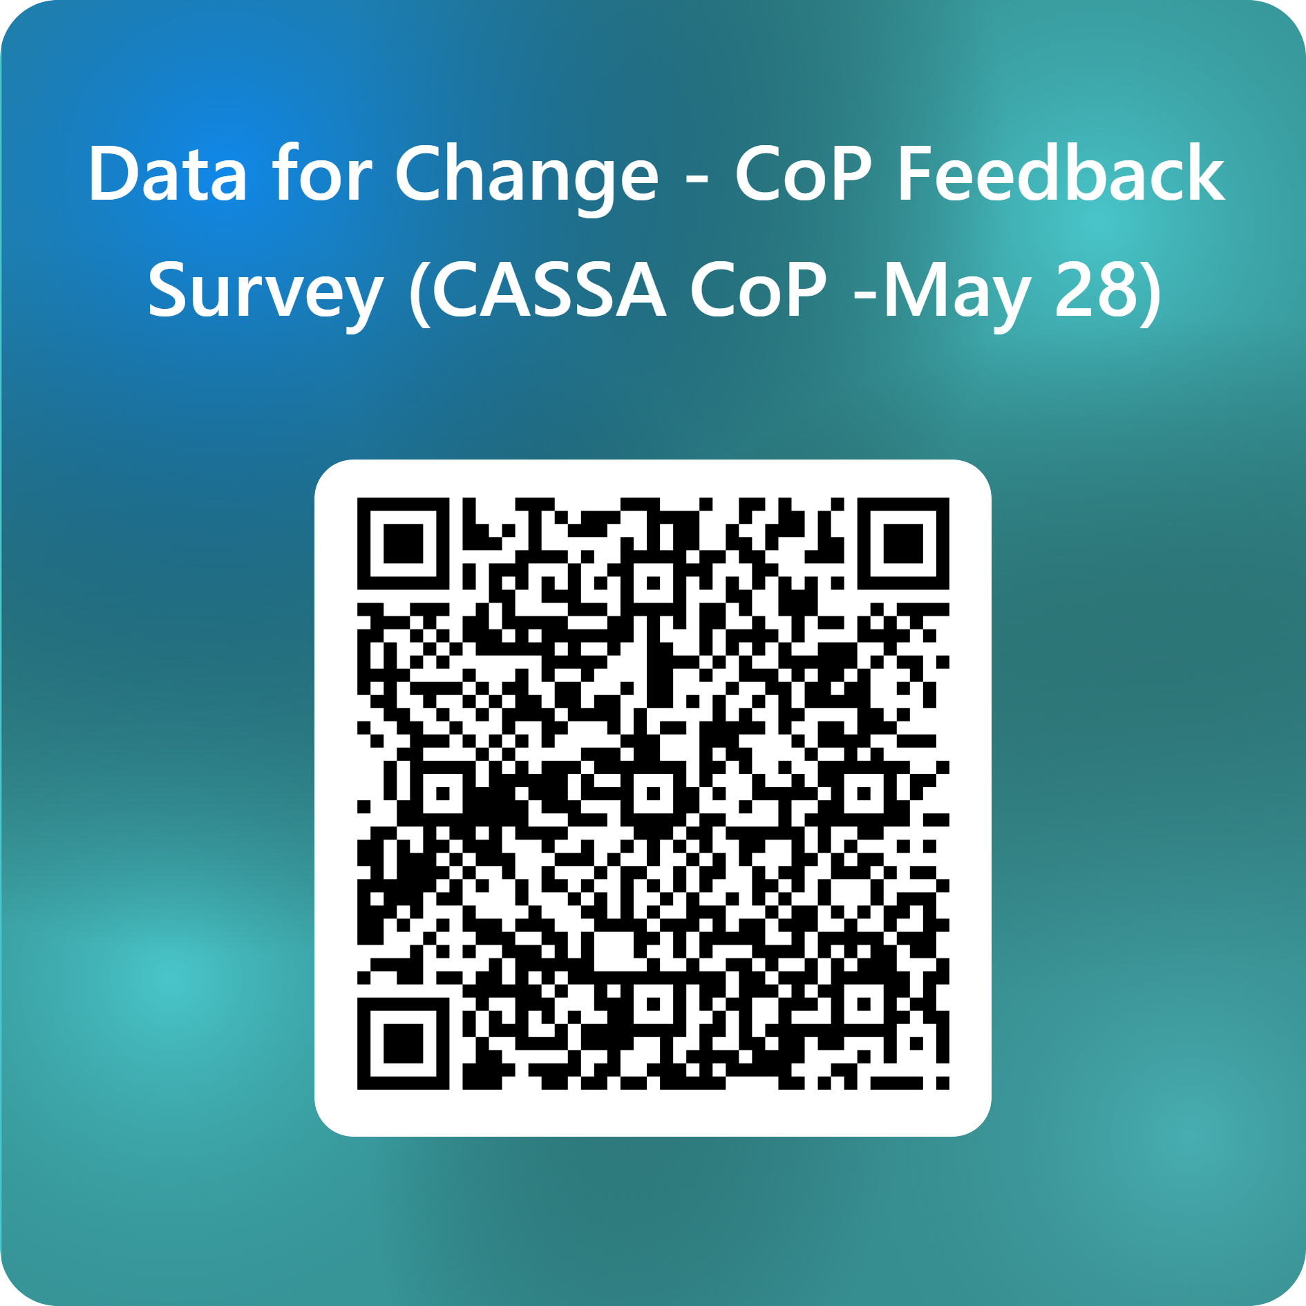
Please Scan this barcode to give feedback

Slide 23
Next workshop
Led by SHIP: Equity Use of Data
October 9, 2025
Registration link in chat

