Slide 1







Data for Change
Capacity Building Learning Series
From Collection to Care: Practicing
Data Equity in Every Step
Thursday, July 31, 2025
1:30pm-3:00pm
Presented by: Council of Agencies Serving South Asians (CASSA)
In Partnership With:
Supported by:

Slide 2

Land Acknowledgement
The work of the Council of Agencies Serving South Asians (CASSA) takes place on traditional Indigenous territories of the Huron-Wendat, Haudenosaunee, and most recently, the territory of the Mississaugas of the Credit First Nations. This territory is part of the Dish with One Spoon Treaty, an agreement between the Anishinaabeg, Haudenosaunee and allied nations to peacefully share and care for the resources around the Great Lakes. This territory is also covered by the Upper Canada Treaties. Today, Tkaronto, the traditional Mohawk name of this area called Toronto which means “trees in the water,” and its surrounding areas are still home to Indigenous people and we are grateful to have the opportunity to meet, work, and play on this territory as settlers.

Slide 3
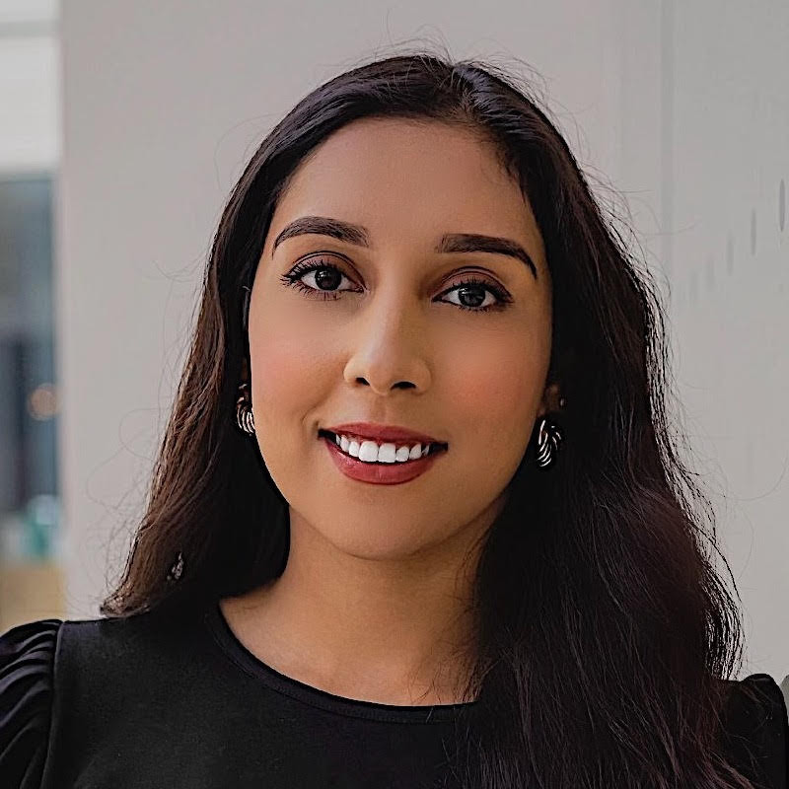
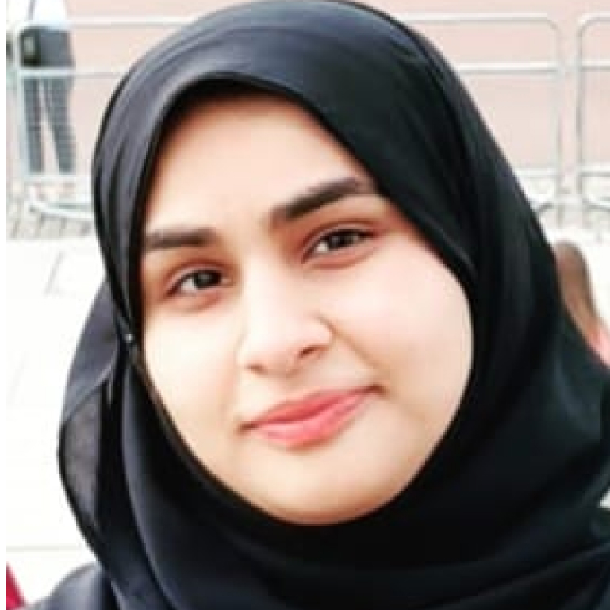
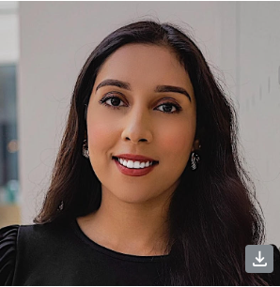
CASSA Team
Ridah Asghar (she/her)
Director of Development
Qurat Al Ain (she/her)
Executive Assistant/Membership Coordinator and Admin Assistant at TNN.
Diploma, Accounting and Business

Slide 4

Council of Agencies Serving South Asians (CASSA)
An umbrella organization with over 120 member agencies. Our mandate is to cultivate the social, economic, political and cultural empowerment of South Asians by serving as a resource for training, research, knowledge mobilization, leadership and capacity building for South Asians, racialized and other marginalized communities.
CASSA aims to create social and systemic change through coalition building, and partnering with other community organizations and institutions who share a similar vision of equipping the communities they serve with the necessary tools, knowledge and resources in order to successfully participate and contribute to Canadian society in all sectors.

Slide 5
Agenda
Land Acknowledgement
Introduction of CASSA
Overview of Data for Change Project
Overview of CoP & Ground Rules
Fireside Chat
Fireside Q&A
Presentations (SHIP + Q&A & Logical Outcomes + Q&A
Close-out

Slide 6
Project Objective
To test SID collection with more service-users to better understand how to best support agencies in:
collecting socio-demographic data
using the data to advance better outcomes for equity-deserving communities
socializing the collection methodology & use of tools across the community social services sector

Slide 7




Data for Change Project Model
Knowledge Mobilization Hub
Project Logistics
Partner Convening
Host Knowledge Mobilization Online Hub
Community of Practice &
Partnership Table
Partnership Table support & participate in project implementation
Community of Practice features a panelist discussion & peer support network for agencies
Community of Practice &
Partnership Table
Capacity Building Sessions
Facilitate capacity building sessions to support agencies with data collection & responsible usage
Capacity Building Sessions
Facilitate capacity building sessions to support agencies with data collection & responsible usage
KNOWLEDGE MOBILIZATION HUB

Slide 8
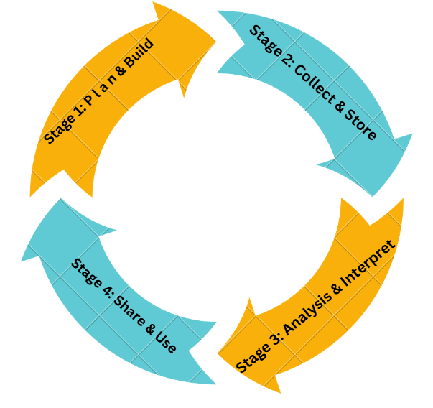
STAGE ONE: PLAN & BUILD
STAGE TWO: COLLECT & STORE
April: Organizational Readiness
June: Org. Change Management
May: Foundations of Data Collection
July: Data Infrastructure
DATA EQUITY 3.0
May: CoP
July: CoP
STAGE THREE: ANALYSIS & INTERPRET
STAGE FOUR: SHARE & USE
August: Trauma Informed Practice
October: Uses of Data
September: Consent & Privacy
November: Data Analysis Framework
September: CoP
December: CoP

Slide 9
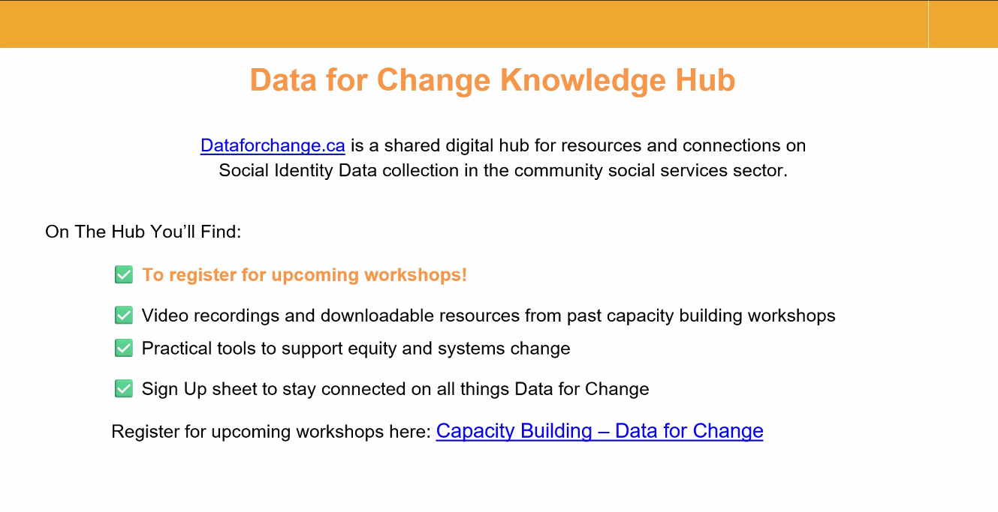

Slide 10
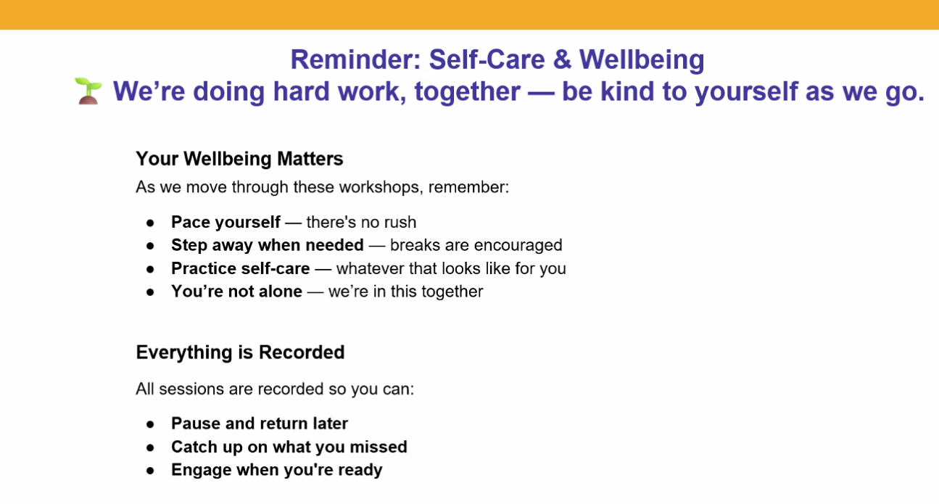
r

Slide 11
Community of Practice (CoP)
Purpose of a CoP:
  Collective Learning: Foster collaboration, knowledge exchange, and leadership development among leaders within the non-profit sector.
  Collective Sharing: Challenges, innovations, and strategies in non-profit leadership, governance, funding and impact.

Slide 12
Community of Practice (CoP)
Ground Rules for CoP
  Brave spaces and building trust
  Respectful communication
  Maintain confidentiality
  Openness to diverse perspectives
  Inclusivity

Slide 13
Fireside Chat

Slide 14
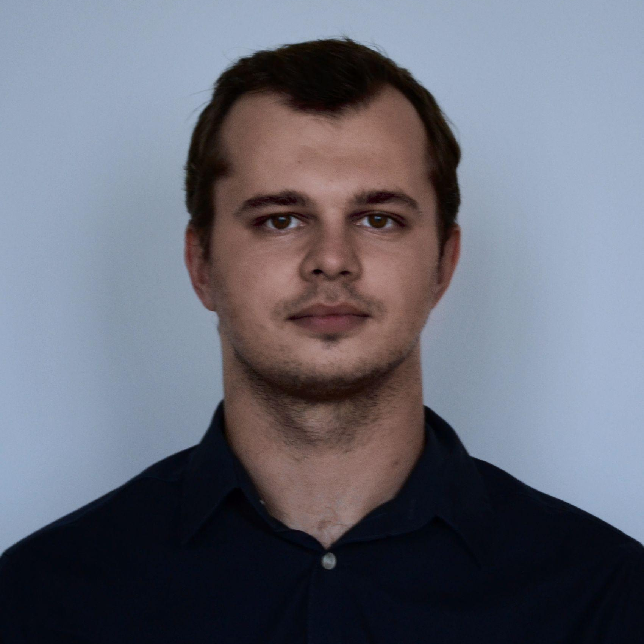
Fireside Chat
Maksym holds a Master’s degree in International Business and Economics of Industrial Organizations from IAE Graduate School of Management in Nice, France. Since October 2024, he has been working as an Equity, Diversity, and Inclusion (EDI) Data Analyst at Jewish Family and Child Service, supporting data collection, analysis, and reporting related to client demographics and organizational equity efforts.
Maksym will highlight Jewish Family and Child Service’s journey in planning, developing, collecting and analyzing Social Identity Data(SID). He will showcase the complexity of their work, organization and the services they provide to answer - “Why collecting data matters for their organization?”
Maksym Chernysh
EDI Data Analyst
Jewish Family and Child Service

Slide 15
Questions and Answers
If you have any questions for Maksym please email dataforchange@findhelp.ca.

Slide 16
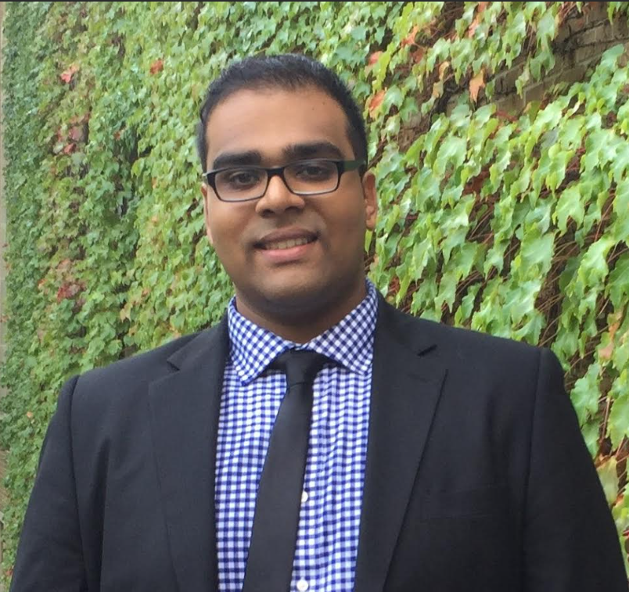


SHIP: Leveraging Power BI at SHIP: Creating the MHA-PDS Audit, Breakdown, and Client Demographics Dashboard
Sajan Jacob Nicole Abruscato Shereen Rampersad
Data Management Manager Manager
Specialist Central Intake & Access EDI
Clinical Health & Wellness Professional Services

Slide 17
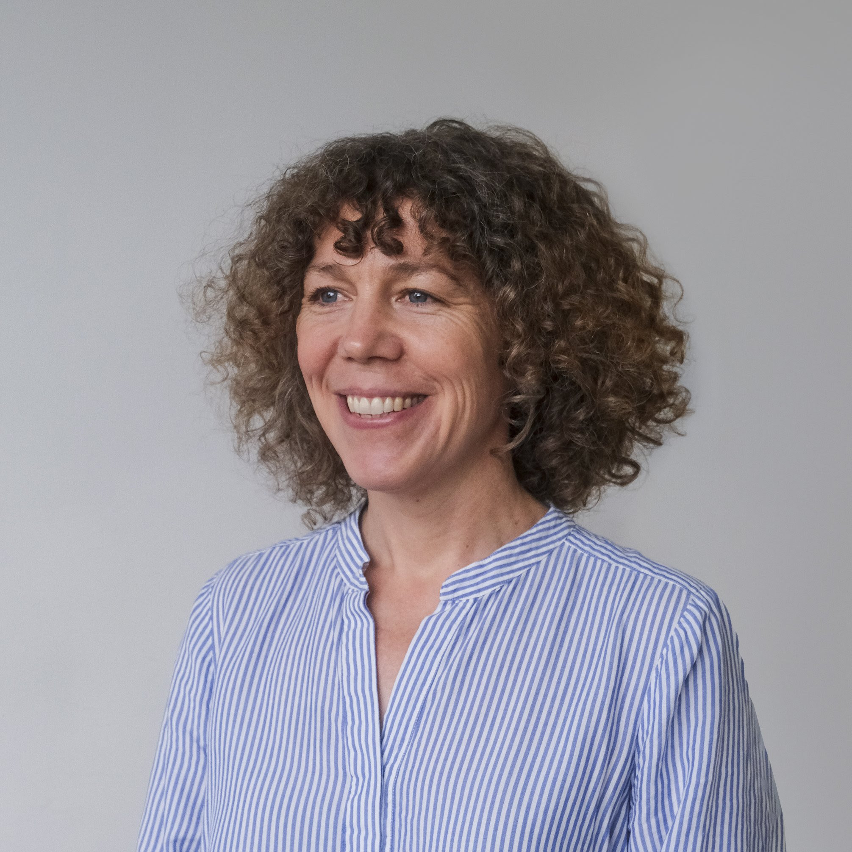

Logical Outcomes: Socio-Demographic Measures That Work
Sophie Llewelyn Medha Aurora
Director of Evaluation and Research Evaluation Analyst

Slide 18
We’d love to hear from you!
💬 Questions?
Ask about anything we’ve covered—or anything we haven’t!
🌟 Best Practices:
What strategies or tools has your organization found helpful?
🤝 Let’s Collaborate:
Share your insights and challenges. We're all here to learn.
📝 Feedback
Share your feedback with us on the Zoom poll in the chat!

Slide 19
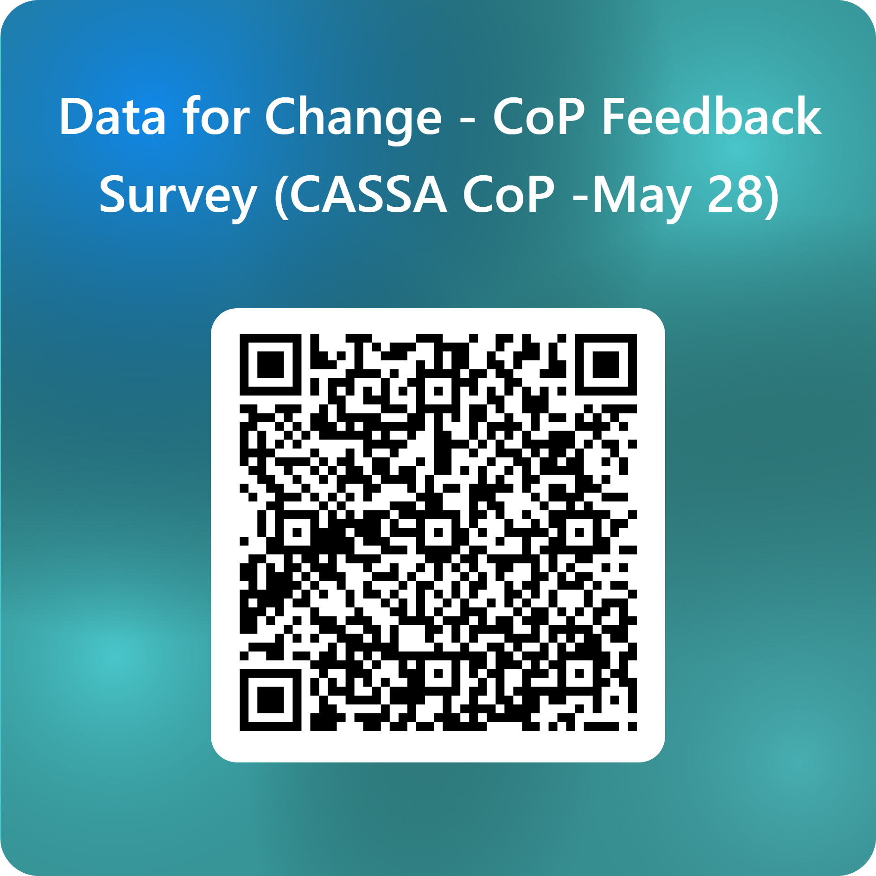
Please Scan this barcode to give feedback

Slide 20
Next workshop
Led by SHIP: August 14, 2025
Registration Link:

